Slide 1
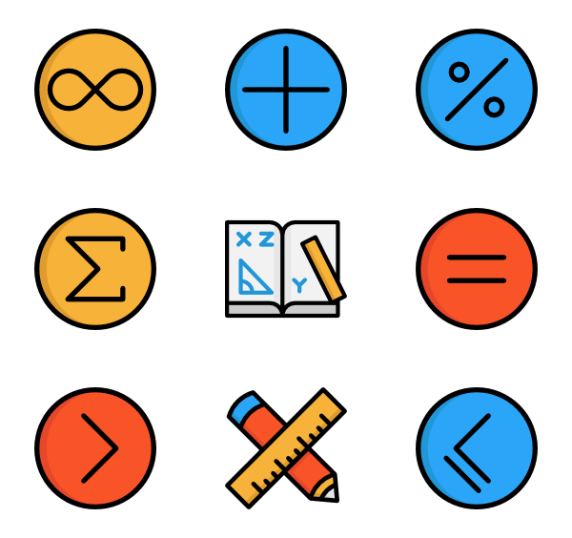



PROBLEM SOLVING PROCESS
Class X
lab 7

Slide 2
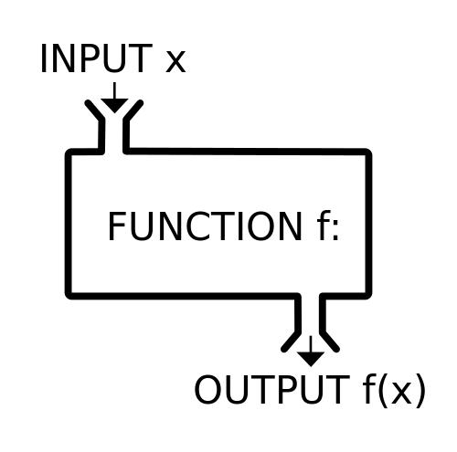
What is a function?
Function is a group of related statements that perform a specific task.

Slide 3
Syntax of Function
def function_name(parameters):
"""docstring"""
statement(s)

Slide 4
Example of a function
def greet(name):
"""This function greets to
the person passed in as
parameter"""
print("Hello, " + name + ". Good morning!")

Slide 5
How to call a function?
Once we have defined a function, we can call it from another function, program or even the Python prompt. To call a function we simply type the function name with appropriate parameters.
>>> greet('Paul') Hello, Paul. Good morning!

Slide 6
Docstring
documentation strings (or docstrings) provide a convenient way of associating documentation with modules, functions, classes, and methods.
>>> print(greet.__doc__)This function greets to the person passed into the name parameter

Slide 7
Example of return
def absolute_value(num):
"""This function returns the absolute
value of the entered number"""
if num >= 0:
return num
else:
return -num
# Output: 2
print(absolute_value(2))
# Output: 4
print(absolute_value(-4))

Slide 8
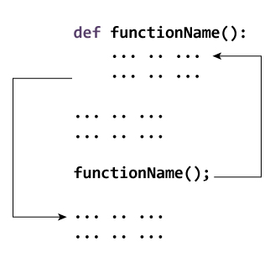
How Function works ?

Slide 9



